Slide 1

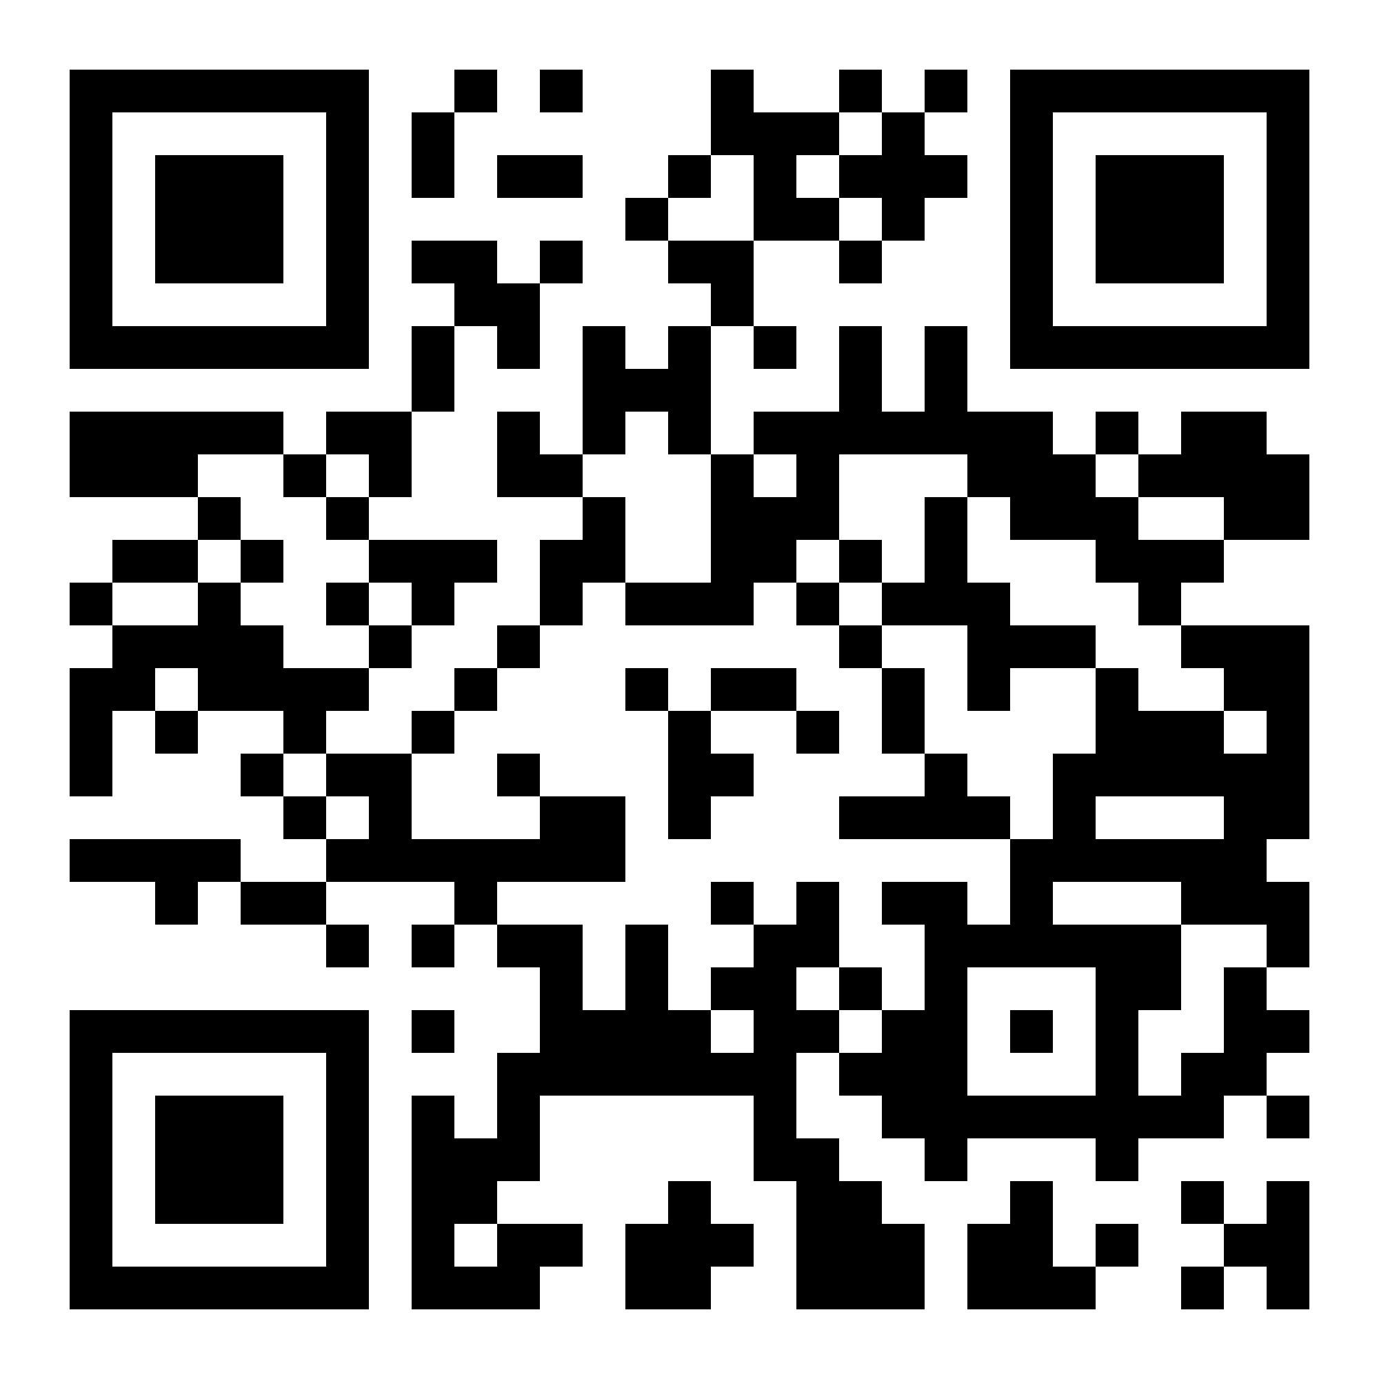
Tickets
The Bedford, Balham - SUN 05/01/25 Doors: 7.15pm h n. Start: 7.45pm Tickets: £20 OTD

